Slide 1
Study of Anomaly Detection Algorithms
Amit Shetty
Tabish Maniar
Vamshi Goud

Slide 2
Unsupervised and non-parametric outlier detection algorithms
Outlier detection is mostly subjective
Scores calculated by these algorithms can be interpreted differently for different use cases

Slide 3
Histogram Based Outlier Score (HBOS)
Most useful as a semi supervised and unsupervised learning outlier detection algorithm
Scales very well to large datasets due to way it handles multivariate data
Calculate a very good outlier score by virtue of its scanning technique
Assumes independence of features similar to Naïve Bayes Algorithm
Is highly versatile when delaying with data having either low of high outlier variation using static and dynamic bin width algorithms

Slide 4
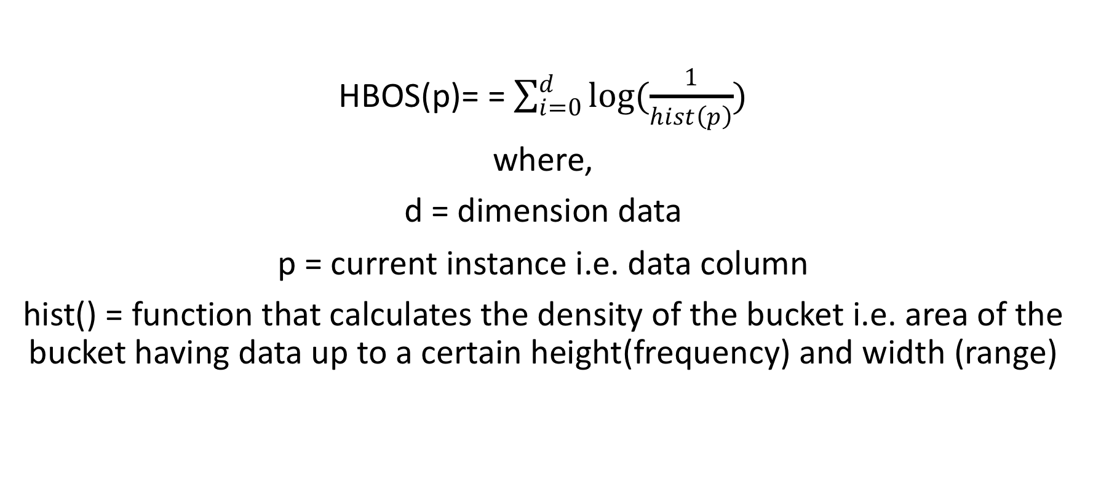
Outlier Score Calculation Formula

Slide 5
Advantages
Is highly efficient as it calculates the score in linear time. O(n) for static bin widths and O(nlog(n)) for dynamic bin width algorithms
Dynamic bin width histograms can solve a major problem facing static bin width histograms i.e. when dealing with extreme outliers empty buckets are not allocated as the scope of the buckets scales with data variation
Independence of data with its neighbors means the algorithm can be scaled to data of varying domains to produce accurate results
Using the logarithmic value for density calculation ensures floating point precision

Slide 6
Disadvantages
Static bin width algorithms cannot account for extreme variations in data as bucket width is fixed and the former can lead to empty bucket allocation
Due to the scope of the score calculation, it works very well on global anomaly detection tasks but when considering a local area it gives very poor results

Slide 7
Clustering based Algorithms
Uses input from clustering algorithm such as K-means.
Unsupervised approach for finding outliers.
Multiple techniques to find outlier score such Cluster Based Locality Outlier Factor, unweighted CBLOF, Local Density Cluster-Based Outlier Factor

Slide 8
Analysis
Some clustering algorithms produce better results.
Increasing number of clusters produce better results.
Needs a clustering algorithm.

Slide 9
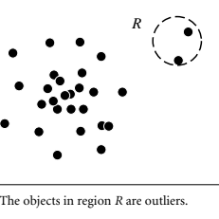
Nearest Neighbour Outlier Detection Algorithm
Nearest neighbour based algorithms (proximity based methods) are used to detect data objects that are outliers.
Assumption: They assume that an object is an outlier if the nearest neighbours of the object are far away in feature space.
Data objects in region R are outliers

Slide 10
There are basically two ways of detecting outliers using proximity based methods
1) Distance- based outlier detection
2) Density-based outlier detection
To compute distance based outliers two approaches are used first approach is a straightforward nested loop approach and second approach is a cell method

Slide 11
Nearest-neighbor based algorithms assign the anomaly score of data instances relative to their neighborhood.
So there are six ways to assign anomaly scores to distinguish outliers
1. k-NN Global Anomaly Score
2. Local Outlier Factor (LOF)
3. Connectivity based Outlier Factor (COF)
4. Local Outlier Probability (LoOP)
5. Influenced Outlierness (INFLO)
6. Local Correlation Integral (LOCI)

Slide 12
Questions?

